Slide 1
Kubernetes
Notes:
1

Slide 2
Namespaces
Partition a single Kubernetes cluster into multiple virtual clusters
Logical entity to represent cluster resources for usage of a particular set of users.
Helps to address the complexity of organizing objects within a cluster
Notes:
2

Slide 3
Namespaces
Can maintain copies of the same objects, with the same names, in app life cycle environment
For Exp: - DEV, STAGING, PROD
Easily apply policies to specific slices of your cluster
For Exp:- ResourceQuota, Network Policy etc
Notes:
3

Slide 4
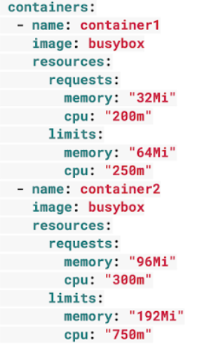
Resource Limits
Requests are what the container is guaranteed to get
Limits make sure a container never goes above a certain value
Notes:
4

Slide 5
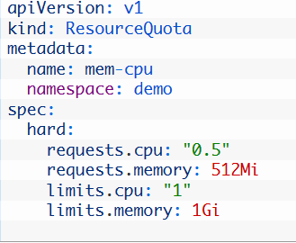
Resource Quotas
requests.cpu is the maximum combined CPU requests in millicores for all the containers in the Namespace.
limits.cpu is the maximum combined Memory limits for all containers in the Namespace
requests.memory is the maximum combined Memory requests for all the containers in the Namespace
limits.memory is the maximum combined Memory limits for all the containers in the Namespace
Notes:
5

Slide 6
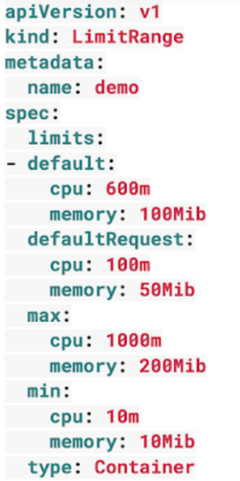
Limit Range
LimitRange applies to an individual container
Can help prevent people from creating super tiny or super large containers inside the Namespace.
Notes:
6

Slide 7
POD Health Checks
Liveness Probe - Kubernetes uses liveness probes to know when to restart a container
Readiness Probe - to decide when the container is available for accepting traffic
Notes:
7

Slide 8
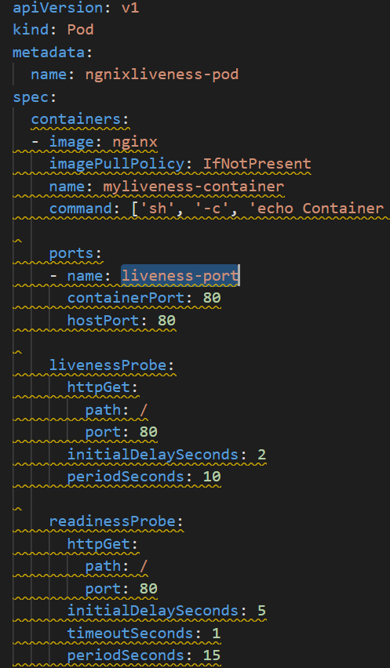
POD Health Checks
initialDelaySeconds - How long to wait before sending a probe after a container starts.
timeoutSeconds How long a request can take to respond before it’s considered a failure.
periodSeconds How often a probe will be sent.
Notes:
8

Slide 9
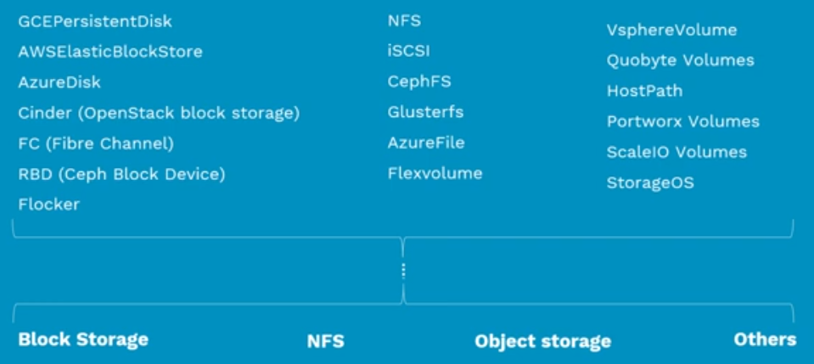
Persistent Volume

Slide 10
Persistent Volumes
Standard API
Block Storage
NFS
Object Storage
Cloud Storage

Slide 11
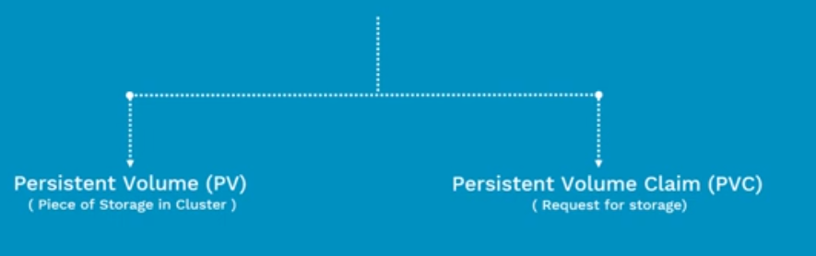
Persistent Volumes
Abstract details of how storage is provided from how it is consumed

Slide 12
What is Persistent Volume (PV)?
Pre Provisioned storage in a Kubernetes cluster
Represent the backend storage entity that a pod might consume.
Data can exists beyond the lifecycle of a POD

Slide 13
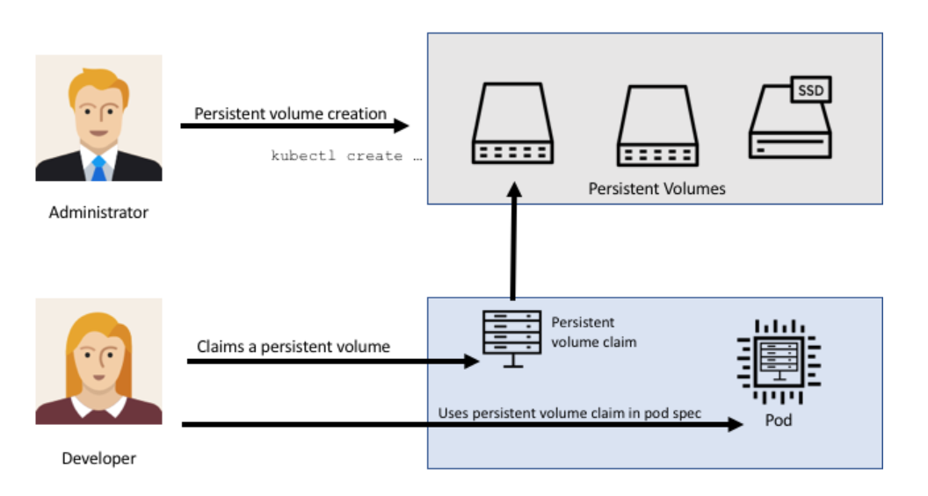
Persistent Volume

Slide 14
Persistent Volume
apiVersion: v1
kind: PersistentVolume
metadata:
name: pv0003
spec:
capacity: storage: 5Gi
accessModes: - ReadWriteOnce
persistentVolumeReclaimPolicy: Recycle
nfs:
path: /tmp
server: 172.17.0.2
Capacity - storage capacity
Access Modes - ReadWriteOnce
ReadOnlyMany
ReadWriteMany
Recycling Policy Retain (manual reclaim)
Recycle

Slide 15
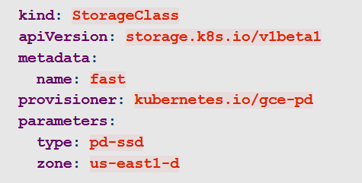
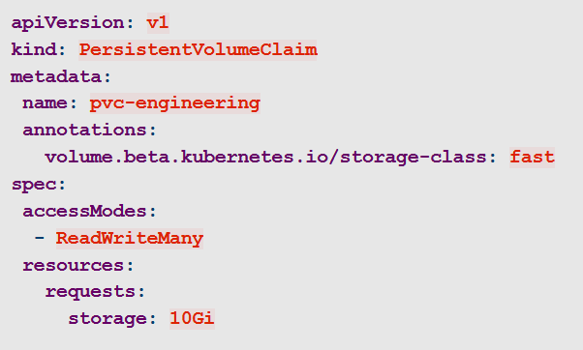
Dynamic Provisioning of volumes
Users can request dynamically provisioned storage by including a storage class annotation in their persistent volume claim:

Slide 16
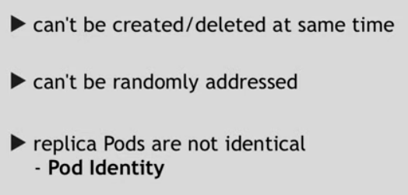
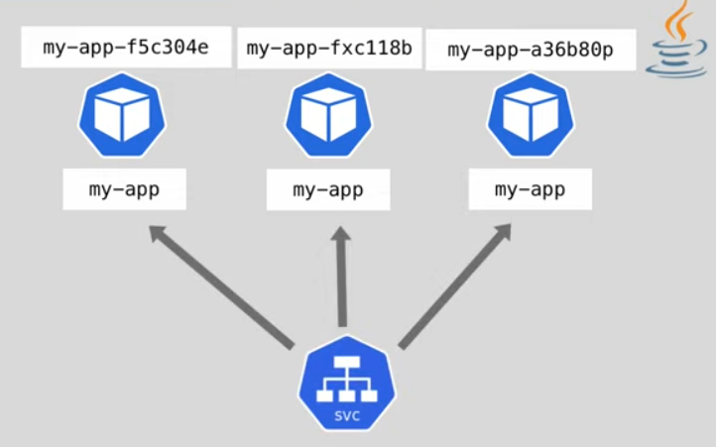
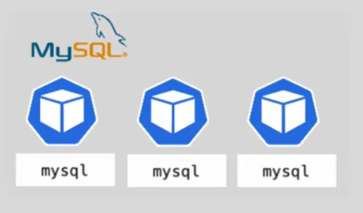
StatefulSets

Slide 17
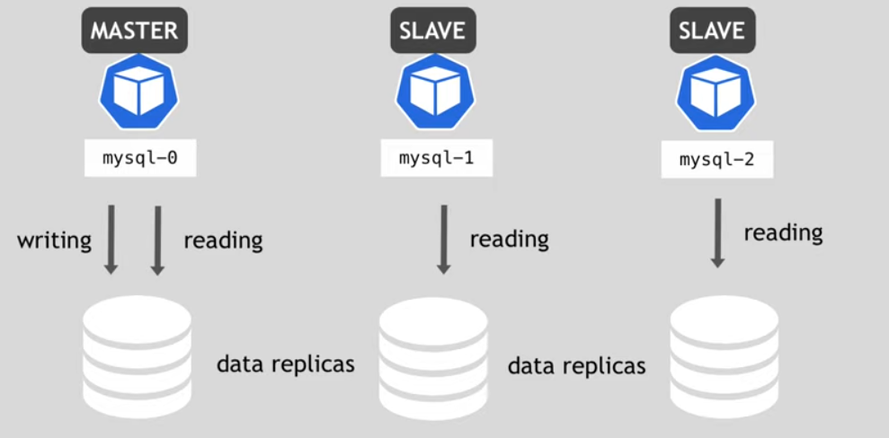
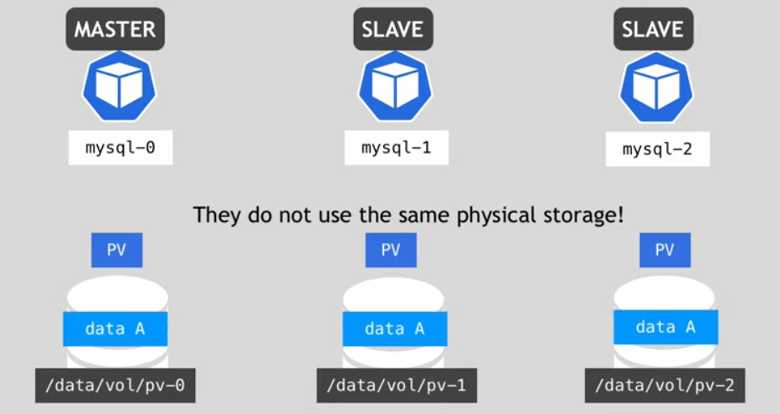
StatefulSets

